Slide 1
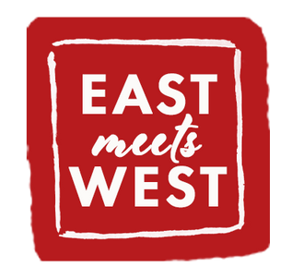
1 | Moodboard
2 | Colour
3 | Typography
4 | Logo
5 | Unique selling points
6 | Brand applications
Brand Kit
For creativity and consistency

Slide 2
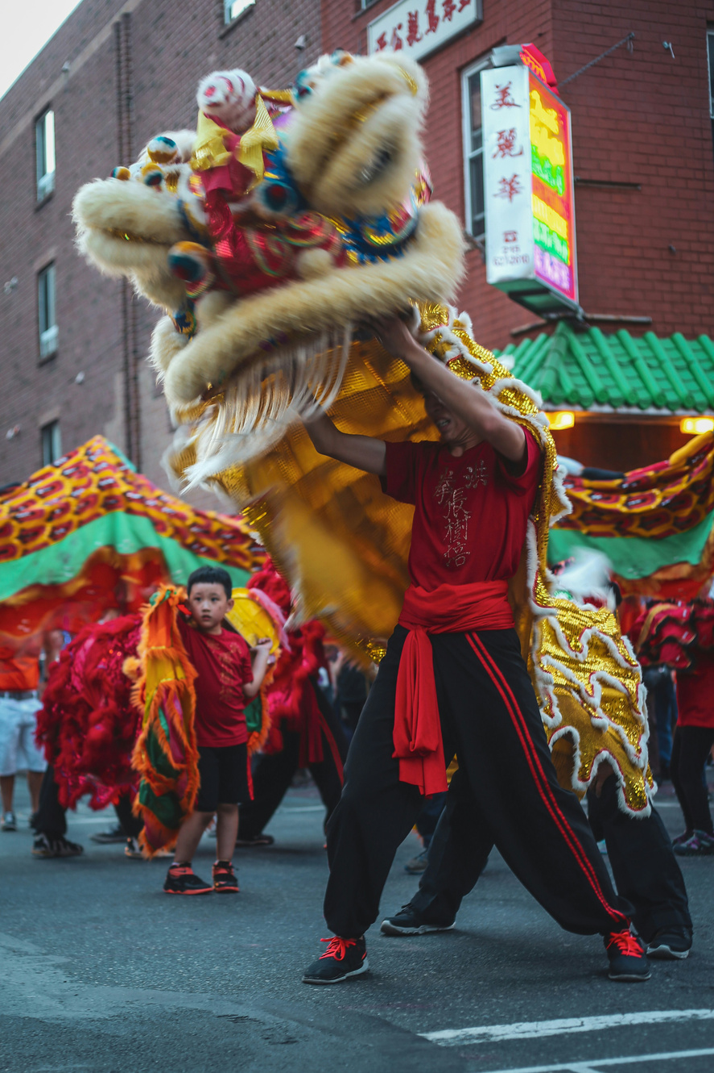
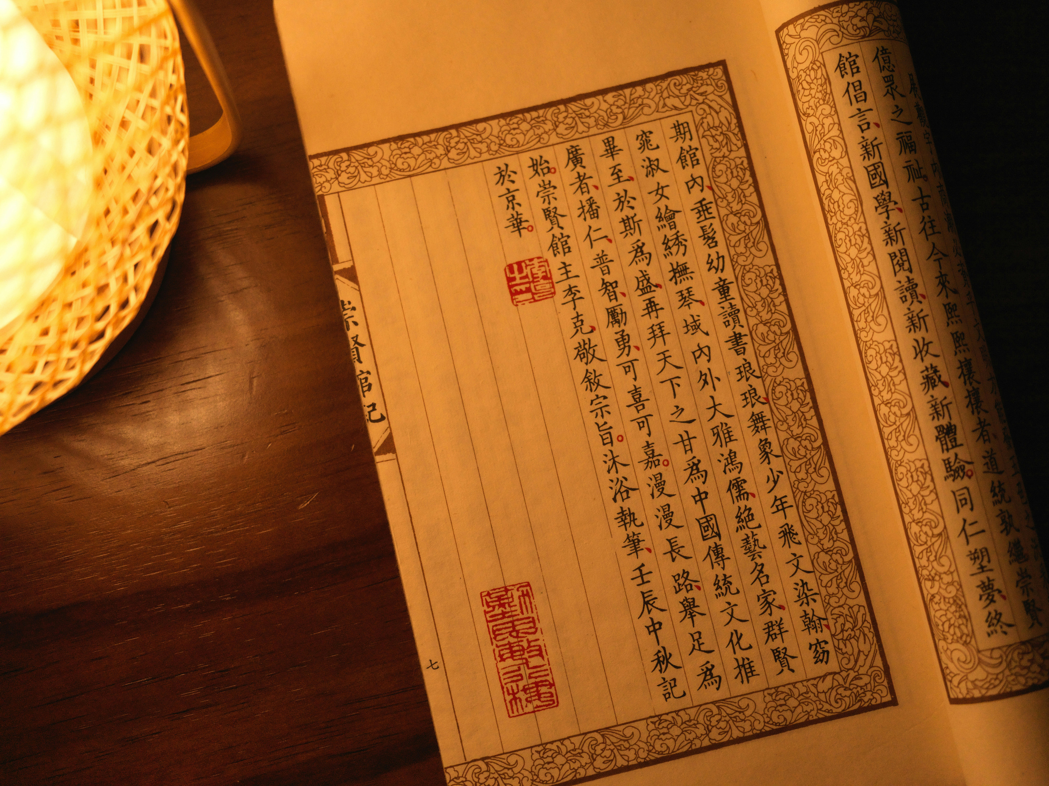
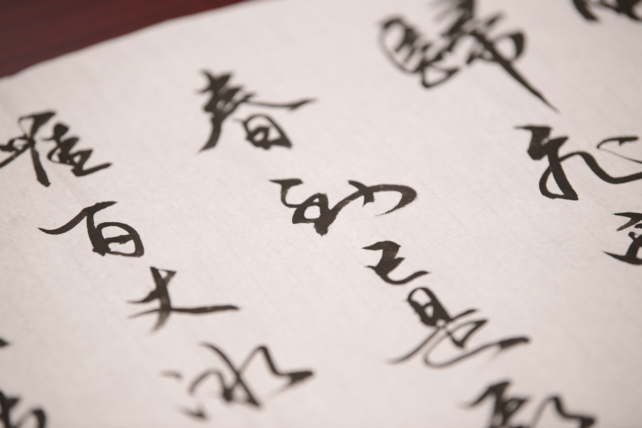
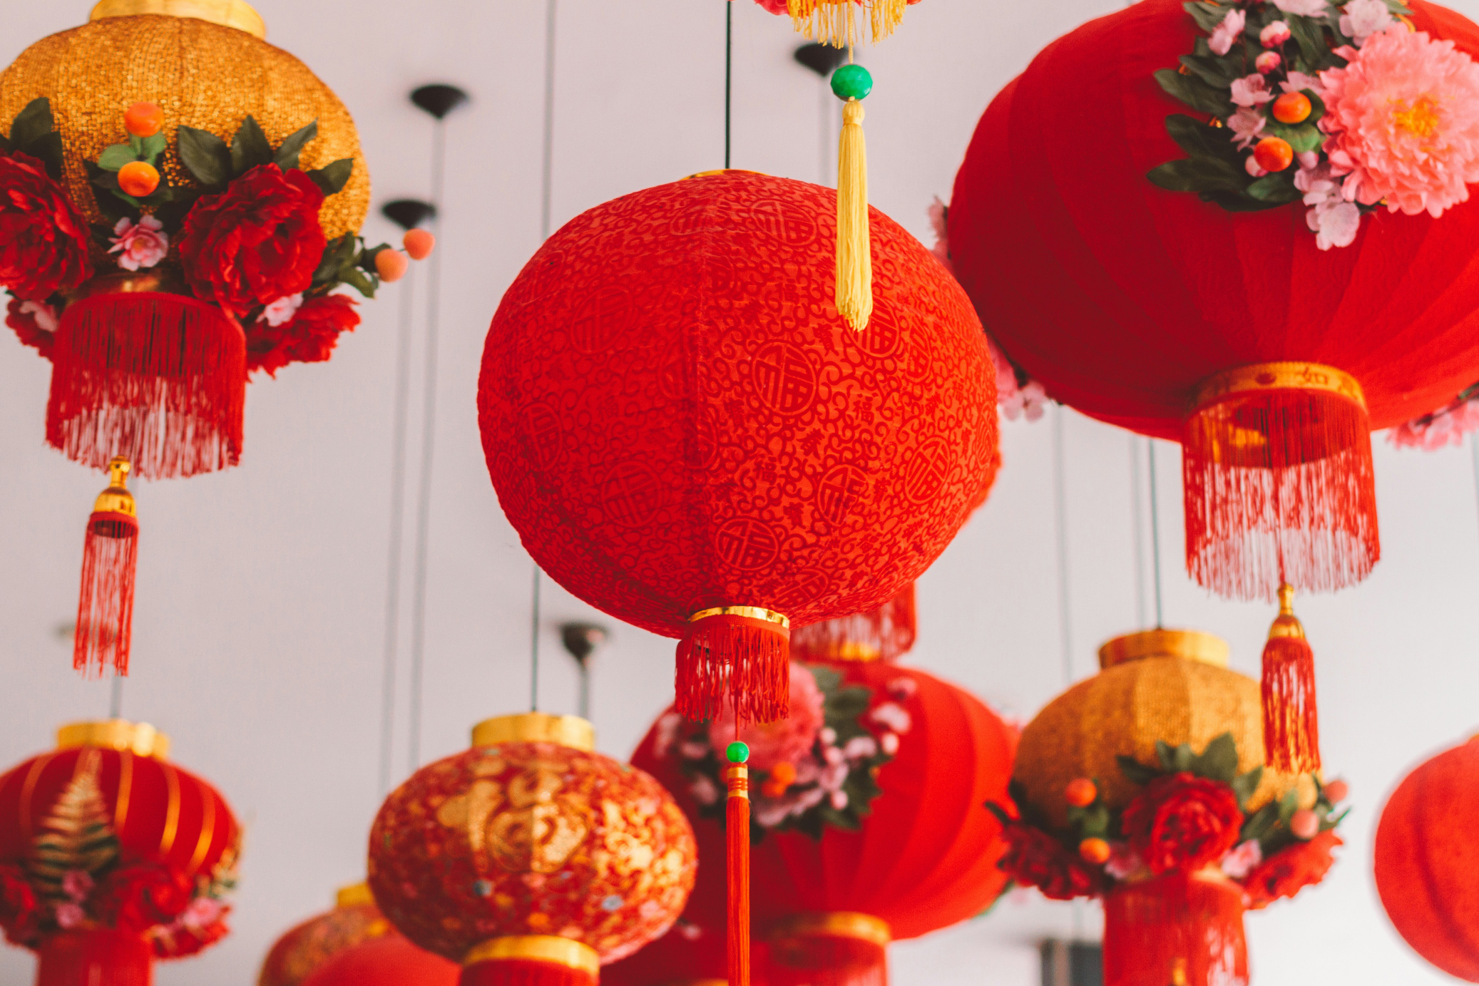
01
Moodboard

Slide 3
#9F9B9B
#b71b1e
02
Colour Palette
#000000
#0156a3
#d5a028
#EEEEEE

Slide 4
03
Typeface
Aa
Aa
PRIMARY FONT
HEADER
Futura
IBM Plex Serif
A B C D E F G H I J K L M N O P Q R S T U V W X Y Z
A B C D E F G H I J K L M N O P Q R S T U V W X Y Z
a b c d e f g h i j k l m n o p q r s t u v w x y z
1 2 3 4 5 6 7 8 9 0
a b c d e f g h i j k l m n o p q r s t u v w x y z
1 2 3 4 5 6 7 8 9 0

Slide 5
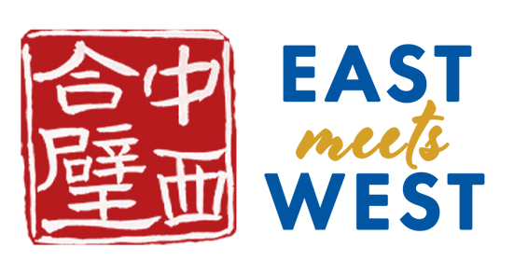
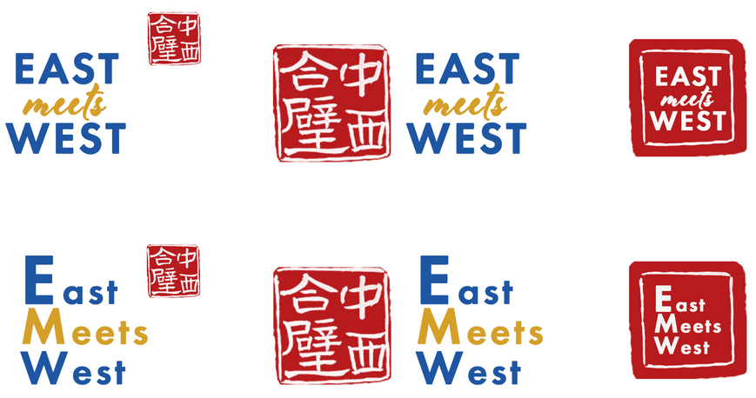
Main Logo
Logo Variation
04
Logo
Drafts

Slide 6
For individuals and families of Chinese heritage or intrigued by the culture who are drawn to a transformative and inclusive community merging cultural enrichment, personal inspiration, mental health empowerment, professional growth, and holistic relaxation, unlike traditional Chinese communities, our annual retreat integrates Chinese cultural immersion, compelling narratives, and fostering meaningful connections, amid activities like golf, spa indulgence, and explorations of Collingwood's rich history.
It's a multi-generational sanctuary where families unite, minds thrive, and networks flourish, nurturing purpose and goodness naturally. Our unique blend of purpose, cultural enlightenment, and personal growth fosters an environment where minds expand within Chinese cultural immersion and meaningful connections.
05
Unique Selling Points
POSITIONING
TAGLINE
Higher purpose and discovery
Unite, Inspire, Discover
Culture Blooms, Bonds Strengthen
Thrive Together, Culturally Inspired
Together in Culture, Together in Growth
Target Audience and Objectives: individuals and families of Chinese heritage or intrigued by the culture who are drawn to a transformative and inclusive community merging cultural enrichment, personal inspiration, mental health empowerment, professional growth, and holistic relaxation
Competitors: traditional Chinese/Asian communities
Benefits and Vision: Our annual retreat integrates Chinese cultural immersion, compelling narratives, and fostering meaningful connections between generations and peers, amid activities like golf, spa indulgence, and explorations of Collingwood's rich history
Evidence and Mission: It's a multi-generational sanctuary where families unite, minds thrive, and networks flourish, nurturing purpose and goodness naturally. Our unique blend of purpose, cultural enlightenment, and personal growth fosters an environment where minds expand within Chinese cultural immersion and meaningful connections.

Slide 7






06
Brand applications
Email marketing campaign, Poster, Website

